Slide 1
Floating Point Numbers (Numerical Methods)

Slide 2
Floating Point Numbers
4
34523 = 3.4523 * 10
0.00023 = 2.3 * 10
-4

Slide 3
Floating Point Numbers
→ usually floats are represented using 32 bits
→ each possible combination of bits represent a given real number
00
01
if we have N bits then we
can represent 2^{N} numbers
10
11
with 32 bit long floats we can represent 2³²
possibe real numbers

Slide 4
Floating Point Numbers
→ usually floats are represented using 32 bits
→ each possible combination of bits represent a given real number
1 bit: the so-called sign bit – 1 for negative and 0 for positive
8 bits: the so-called exponent field
these bits represent the exponent of the floating point number
23 bits: the so-called mantissa
it is normalized to be in the range [0.5,1]

Slide 5
Floating Point Numbers
s
(e-127)
(-1) m 2
x
x
Why to use 127 bias?
we have 8 bits to store the exponent – instead of storing it as a signed two’s
complement number it’s easier to add -127 (since the smallest value it can be is -127) to
the exponent and just store it as an unsigned number.
What is the range for floats?
1.4E-45 to 3.4E38

Slide 6
Doubles
→ usually doubles are represented using 64 bits
→ each possible combination of bits represent a given real number
1 bit: the so-called sign bit – 1 for negative and 0 for positive
11 bits: the so-called exponent field
these bits represent the exponent of the floating point number
52 bits: the so-called mantissa
it is normalized to be in the range [0.5,1]

Slide 7
Doubles
s
(e-1023)
(-1) m 2
x
x
Why to use 1023 bias?
we have 11 bits to store the exponent – instead of storing it as a signed two’s
complement number it’s easier to add -1023 (since the smallest value it can be is -1023) to
the exponent and just store it as an unsigned number.
What is the range for doubles?
4.94E-324 to 1.797E308

Slide 8
Accuracy and Precision (Numerical Methods)

Slide 9
Precision and Accuracy
ACCURACY is the closeness of a measured value to the known value
PRECISION is independent of accuracy it is a measure of statistical variability
π = 3.14159265...
we calculate it on our own and get 3.142345678
What is the precision? 10 digits of precision
What is the accuracy? 3 digits of accuracy

Slide 10
Precision and Accuracy
ACCURACY is the closeness of a measured value to the known value
PRECISION is independent of accuracy it is a measure of statistical variability
We can achieve 6-7 digits of accuracy with floats and
14-15 digits of accuracy with doubles
π = 3.14159265...
we calculate it on our own and get 3.142345678
What is the precision? 10 digits of precision
What is the accuracy? 3 digits of accuracy

Slide 11
Rounding Errors
dealing with integers is quite deterministic – we will end up with
the exact same values over and over again
floating point numbers are not exact because real numbers require an
infinite number of digits for representation
5 + 5
1
= 0.333333...
3

Slide 12
Performance (Numerical Methods)

Slide 13
Performance
1.) Java is one of the most popular object oriented programming languages
Why is it important? Because 80% of the code development
is spent on maintenance and it is far more convenient to modify
object orinted Java code than C code
2.) if we implement the same problem with the same approach in C then of course
C will be faster (10x faster approximately)

Slide 14
Performance
1.) Java is one of the most popular object oriented programming languages
Why is it important? Because 80% of the code development
is spent on maintenance and it is far more convenient to modify
object orinted Java code than C code
2.) if we implement the same problem with the same approach in C then of course
C will be faster (10x faster approximately)
BUT THIS IS NOT ALWAYS TRUE !!!
object oriented code is quite efficient especially when it comes to complex algorithms – good object oriented implementation may outperform C code

Slide 15
Performance
3.) modern applications and algorithms run on multiple CPU cores
It is significantly easier and more efficient to write concurrent
programming code in Java than in C
+ usually the underlying data structures, thread control and
code optimizations that matter

Slide 16
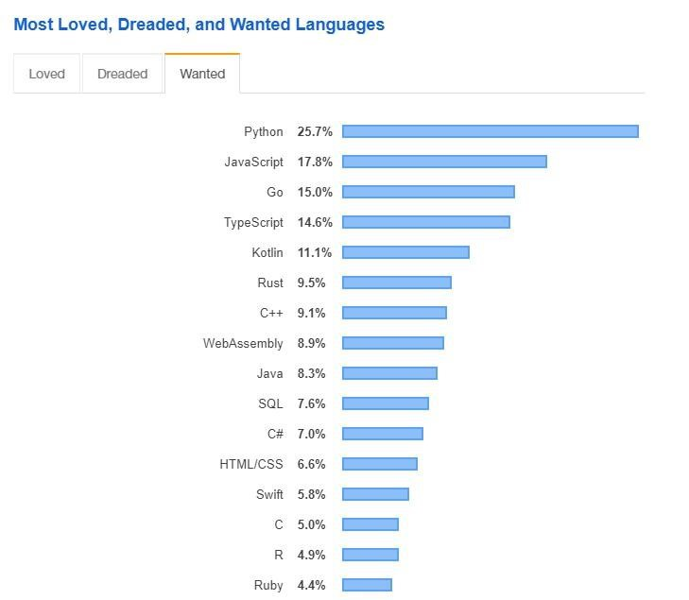
Python Programming Language
Python is the #1 programming language mainly because of scientific computing and machine learning
there are a huge number of libraries you can rely on – SciPy, SkLearn or Keras
data science and artificial intelligence related applications rely extremely heavily on Python
most of the scientific community use Python – physics simulations, complex networks etc.

Slide 17
Matrix Operations (Numerical Methods)

Slide 18
Matrix Operations
a given A matrix is a rectangular array or table of numbers
matrices represent linear maps and allow explicit computations in linear algebra
most of the problems can be reduced to linear algebra and matrix operations
it has a huge amount of applications in computer science, physics and engineering (linear programming, differential equations, PageRank algorithm and machine learning)

Slide 19
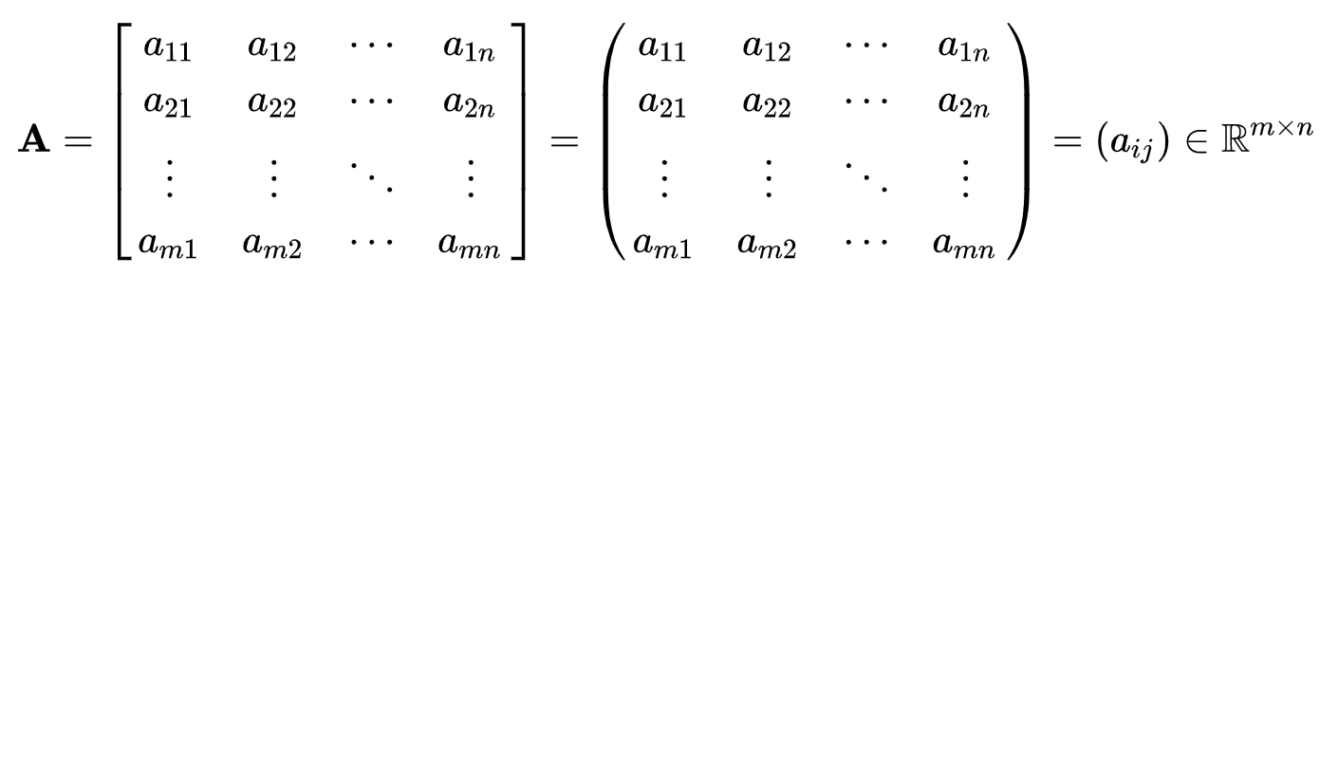
Matrix Operations

Slide 20
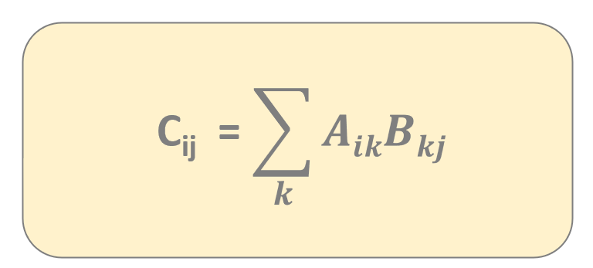
Matrix Operations
1
2
1
2
*
=
3
4
2
1

Slide 21
Matrix Operations
1
2
1
2
5
*
=
3
4
2
1

Slide 22
Matrix Operations
1
2
1
2
5
4
*
=
3
4
2
1

Slide 23
Matrix Operations
1
2
1
2
5
4
*
=
3
4
2
1
11

Slide 24
Matrix Operations
1
2
1
2
5
4
*
=
3
4
2
1
11
10

Slide 25
Matrix Operations (Numerical Methods)

Slide 26
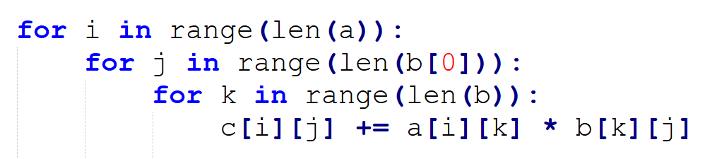
Matrix Multiplication
this is the naive implementation of matrix
multiplication with 3 nested for loops
THIS IS WHY THIS APPROACH HAS O(N³) RUNNING TIME
there are several other approaches
that can reduce the running time

Slide 27
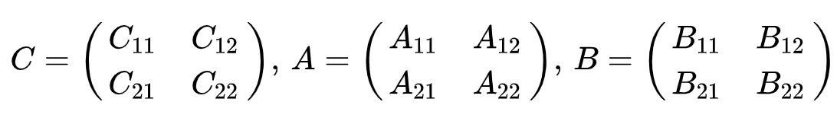
Matrix Multiplication
we can split the original matrix into smaller and smaller
sub-matrixes until we end up with scalar multiplication
THIS IS A DIVIDE-AND-CONQUER APPROACH WITH RECURSION !!!
works for all square matrices whose dimension are powers of 2 (2^{N} x 2^{N})
but this recursive approach still has O(N³) running time

Slide 28
Matrix Multiplication
maybe we can use parallelization and try to multiply matrixes with multiple processors or processor cores
constraint: the number of cores used must be an exact square root
usually this approach is not efficient unless we use lots of processors or processor cores (>30 processors)
we do not have so many processors in average computers

Slide 29
Matrix Operations (Numerical Methods)

Slide 30
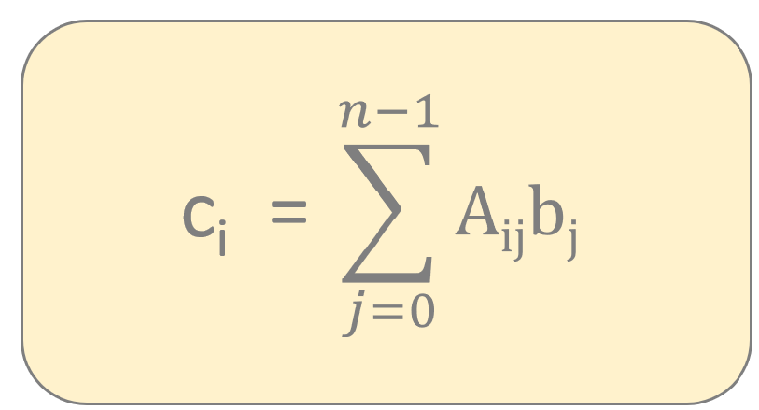
Matrix Vector Multiplication
1
2
1
*
=
3
4
2

Slide 31
Matrix Vector Multiplication
1
2
1
5
*
=
3
4
2

Slide 32
Matrix Vector Multiplication
1
2
1
5
*
=
3
4
2
11

Slide 33
Matrix Operations (Numerical Methods)

Slide 34
Inner Product - Vector Vector Multiplication
1
4
*
=
8
2
2

Slide 35
Gauss Elimination (Numerical Methods)

Slide 36
Gauss Elimination
It is very common in linear algebra that we want to find the solution
of N linear algebraic equations with N unknown variables
A x = b
a huge number of problems can be reduced to this equation
(such as differential equations, interpolation or least squares method etc.)

Slide 37
Gauss Elimination
It is very common in linear algebra that we want to find the solution
of N linear algebraic equations with N unknown variables
„A system of linear equations can be placed into matrix form where every equation is a row and every variable is a column”
A x = b
a huge number of problems can be reduced to this equation
(such as differential equations, interpolation or least squares method etc.)

Slide 38
Gauss Elimination
x + 5y – 2z = 2
2x + 3y + z = 5
2x + 4y – 3z = 2

Slide 39
Gauss Elimination
1
5
-2
x
2
2
3
1
y
=
5
2
4
-3
z
2

Slide 40
Gauss Elimination
1
5
-2
2
2
3
1
5
2
4
-3
2
this is the so-called augmented coefficient matrix representation
(we append the b constant vector to the A matrix)

Slide 41
Gauss Elimination
If we want to solve this linear system then we have to transform the original
equations into equvivalent equations (that can be solved more easily)
exchange 2 equations without any problem

Slide 42
Gauss Elimination
If we want to solve this linear system then we have to transform the original
equations into equvivalent equations (that can be solved more easily)
exchange 2 equations without any problem
multiply an equations by a non-zero constant

Slide 43
Gauss Elimination
If we want to solve this linear system then we have to transform the original
equations into equvivalent equations (that can be solved more easily)
exchange 2 equations without any problem
multiply an equations by a non-zero constant
multiply an equation by a nonzero constant and then subtracting it from another equation

Slide 44
Gauss Elimination
If we want to solve this linear system then we have to transform the original
equations into equvivalent equations (that can be solved more easily)
These are the so-called elementary operations
that do not change the solution
exchange 2 equations without any problem
multiply an equations by a non-zero constant
multiply an equation by a nonzero constant and then subtracting it from another equation

Slide 45
Gauss Elimination
If we want to solve this linear system then we have to transform the original
equations into equvivalent equations (that can be solved more easily)
These are the so-called elementary operations
that do not change the solution
„With row operations we transform the original system of
equations into an upper triangular system then we use
back-substitution to solve the problem”
exchange 2 equations without any problem
multiply an equations by a non-zero constant
multiply an equation by a nonzero constant and then subtracting it from another equation

Slide 46
Gauss Elimination
1
5
-2
2
2
3
1
5
2
4
-3
2

Slide 47
Gauss Elimination
1
5
-2
2
2
3
1
5
2
4
-3
2
A₂ = A₂ – 2 x A₁

Slide 48
Gauss Elimination
1
5
-2
2
0
-7
5
1
2
4
-3
2

Slide 49
Gauss Elimination
1
5
-2
2
0
-7
5
1
2
4
-3
2
A₃ = A₃ – 2 x A₁

Slide 50
Gauss Elimination
1
5
-2
2
0
-7
5
1
0
-6
1
-2

Slide 51
Gauss Elimination
1
5
-2
2
0
-7
5
1
0
-6
1
-2

Slide 52
Gauss Elimination
1
5
-2
2
0
-7
5
1
0
-6
1
-2
A₃ = A₃ – $\frac{6}{7}$ x A₂

Slide 53


Gauss Elimination
1
5
-2
2
0
-7
5
1
0
0
-$\frac{23}{7}$
-$\frac{20}{7}$

Slide 54
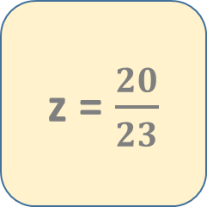
Gauss Elimination
1
5
-2
2
0
-7
5
1
0
0
-$\frac{23}{7}$
-$\frac{20}{7}$
z = $\frac{20}{23}$

Slide 55
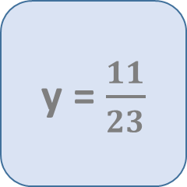
Gauss Elimination
1
5
-2
2
0
-7
5
1
0
0
-$\frac{23}{7}$
-$\frac{20}{7}$
z = $\frac{20}{23}$
y = $\frac{11}{23}$

Slide 56
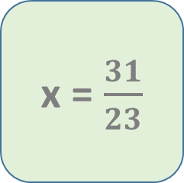
Gauss Elimination
1
5
-2
2
0
-7
5
1
0
0
-$\frac{23}{7}$
-$\frac{20}{7}$
z = $\frac{20}{23}$
y = $\frac{11}{23}$
x = $\frac{31}{23}$

Slide 57
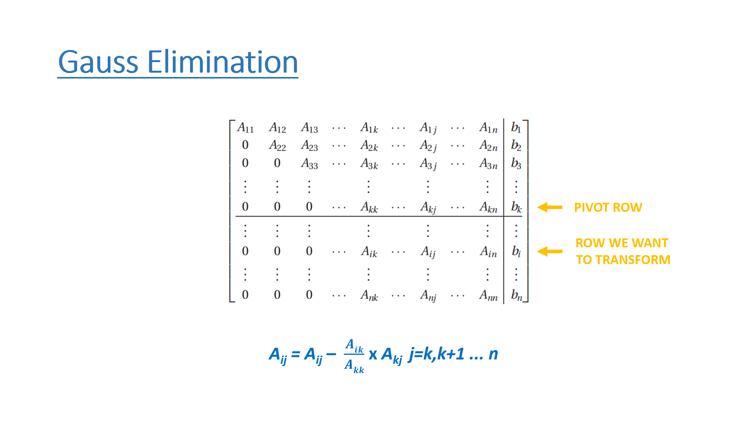
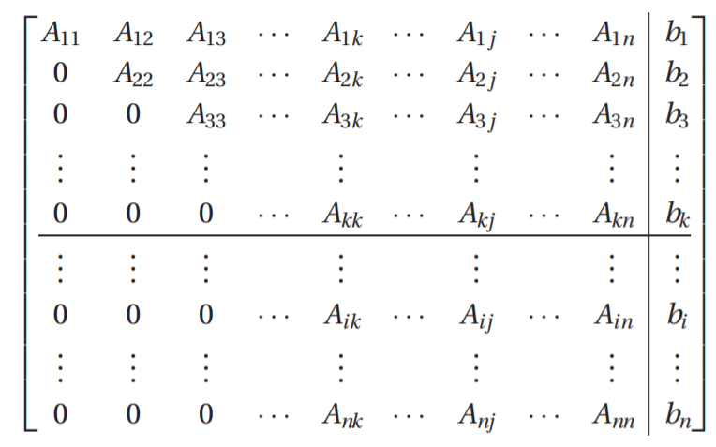
Gauss Elimination
PIVOT ROW
ROW WE WANT
TO TRANSFORM
A_{ij} = A_{ij} – $\frac{Aik}{Akk}$ x A_{kj} j=k,k+1 ... n

Slide 58
Gauss Elimination
1
5
-2
2
0
-7
5
1
0
0
1
-2
x_{n-1} = b_{n-1} / A_{(n-1)(n-1)}

Slide 59

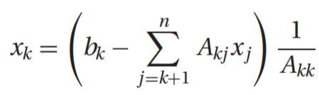
Gauss Elimination
note that we start with the last unknown
x_{n-1} variables and we go backwards
x_{n-1}, x_{n-2} ... have already been computed
(and we store them in b vector)
1
5
-2
2
0
-7
5
1
0
0
1
-2

Slide 60
Numerical Stability (Numerical Methods)

Slide 61
Numerical Stability
2
1
x
3
=
2
1.001
y
0

Slide 62
Numerical Stability
2
1
x
3
=
2
1.001
y
0
x = 1501.5
y = -3000

Slide 63
Numerical Stability
2
1
x
3
=
2
1.002
y
0

Slide 64
Numerical Stability
2
1
x
3
=
2
1.002
y
0
x = 751.5
y = -1500

Slide 65
Numerical Stability
numerical stability refers to how a malformed input affects the execution of an algorithm
for a numerically stable algorithm – small changes in input have little effects on the output
when we have numerically unstable algorithms then small changes cause huge changes in output

Slide 66
Numerical Stability
The original matrix can be perturbated with small errors (fluctations) which is quite
often if we are dealing with floating point numbers
(A + ε_{ij})x = b
inevitable roundoff errors during the solution process that are equivalent
to introducing small changes into the coefficient matrix
WE WANT TO AVOID DEALING WITH ILL-CONDITIONED MATRIXES !!!

Slide 67
Numerical Stability
PARTIAL PIVOTING
partial pivoting means selecting
the row with the largest element
so we change the rows of the
linear system if necessary
it improves numerical stability
of the linear system
COMPLETE PIVOTING
complete pivoting means selecting
the row or the column with
the largest element
so we change the rows or the
columns of the linear system
if necessary
it improves numerical stability
but usually partial pivoting
is just fine

Slide 68
Singular Matrix (Numerical Methods)

Slide 69
Singular Matrixes
A given NxN square matrix is singular if it is not invertible which means
that the determinant is zero
2
6
1
3
det A = 2 * 3 – 6 * 1 = 0
THERE IS NO SOLUTION FOR A LINEAR SYSTEM IF THE UNDERLYING MATRIX IS SINGULAR !!!!

Slide 70
Singular Matrixes
0
0
0
0
0
THE UNDERLYING MATRIX IS SINGULAR IF ONE OF
ITS ROWS CONTAINS ALL ZEROS !!!!

Slide 71
Singular Matrixes
0
0
0
0
THE UNDERLYING MATRIX IS SINGULAR IF ONE OF
ITS COLUMNS CONTAINS ALL ZEROS !!!!

Slide 72
Portfolio Optimization (Numerical Methods)

Slide 73
Portfolio Optimization
A total of $24 000 is invested into 2 corporate bonds that pay 3.5% and 5% simple interest. The investor wants an annual interest incomeof $930 from the investment. What amount should be invested in the bonds?
P(t)
t

Slide 74
Portfolio Optimization
A total of $24 000 is invested into 2 corporate bonds that pay 3.5% and 5% simple interest. The investor wants an annual interest incomeof $930 from the investment. What amount should be invested in the bonds?
P(t)
x: the amount invested into the first corporate
bond with 3.5% return
y: the amount invested into the second
corporate bond with 5% return
t

Slide 75
Portfolio Optimization
A total of $24 000 is invested into 2 corporate bonds that pay 3.5% and 5% simple interest. The investor wants an annual interest incomeof $930 from the investment. What amount should be invested in the bonds?
P(t)
x + y = 24 000
3.5
5
x +
y = 930
100
100
t

Slide 76
Portfolio Optimization
A total of $24 000 is invested into 2 corporate bonds that pay 3.5% and 5% simple interest. The investor wants an annual interest incomeof $930 from the investment. What amount should be invested in the bonds?
P(t)
1
1
x
24 000
*
=
0.035
0.05
y
930
WE CAN USE GAUSSIAN-ELIMINATION TO OBTAIN THE EFFICIENT PORTFOLIO !!!
t

Slide 77
Eigenvectors (Numerical Methods)

Slide 78
Eigenvectors
In linear algebra eigenvector is a non-zero vector whose direction does not
change when a given linear transformation is applied
eigenvalue is the factor by which
the eigenvector is scaled
A x = λ x
eigenvector

Slide 79
Eigenvectors
In linear algebra eigenvector is a non-zero vector whose direction does not
change when a given linear transformation is applied
eigenvalue is the factor by which
the eigenvector is scaled
A x = λ x
eigenvector

Slide 80
Eigenvectors
In linear algebra eigenvector is a non-zero vector whose direction does not
change when a given linear transformation is applied
det (A - λ I) = 0
this is the equation we have to solve to get the λ eigenvalues
and then we can calculate the eigenvectors solving a linear system
(with Gaussian elimination for example)

Slide 81
Eigenvectors
In linear algebra eigenvector is a non-zero vector whose direction does not
change when a given linear transformation is applied
5
-2
9
-6

Slide 82
Eigenvectors
In linear algebra eigenvector is a non-zero vector whose direction does not
change when a given linear transformation is applied
5-λ
-2
det = 0
9
-6-λ

Slide 83
Eigenvectors
In linear algebra eigenvector is a non-zero vector whose direction does not
change when a given linear transformation is applied
5-λ
-2
det = 0
9
-6-λ
λ₁= 3 λ₂=-4

Slide 84
Eigenvectors
In linear algebra eigenvector is a non-zero vector whose direction does not
change when a given linear transformation is applied
5-λ₁
-2
x
0
*
=
9
-6-λ₁
y
0

Slide 85
Eigenvectors
In linear algebra eigenvector is a non-zero vector whose direction does not
change when a given linear transformation is applied
2
-2
x
0
*
=
9
-9
y
0

Slide 86
Eigenvectors
In linear algebra eigenvector is a non-zero vector whose direction does not
change when a given linear transformation is applied
x
1
=
y
1

Slide 87
Eigenvectors
In linear algebra eigenvector is a non-zero vector whose direction does not
change when a given linear transformation is applied
1
v₁
=
1

Slide 88
Eigenvectors
In linear algebra eigenvector is a non-zero vector whose direction does not
change when a given linear transformation is applied
5-λ₂
-2
x
0
*
=
9
-6-λ₂
y
0

Slide 89
Eigenvectors
In linear algebra eigenvector is a non-zero vector whose direction does not
change when a given linear transformation is applied
9
-2
x
0
*
=
9
-2
y
0

Slide 90
Eigenvectors
In linear algebra eigenvector is a non-zero vector whose direction does not
change when a given linear transformation is applied
x
2
=
y
9

Slide 91
Eigenvectors
In linear algebra eigenvector is a non-zero vector whose direction does not
change when a given linear transformation is applied
2
v₂
=
9

Slide 92
Applications of Eigenvectors (Numerical Methods)

Slide 93



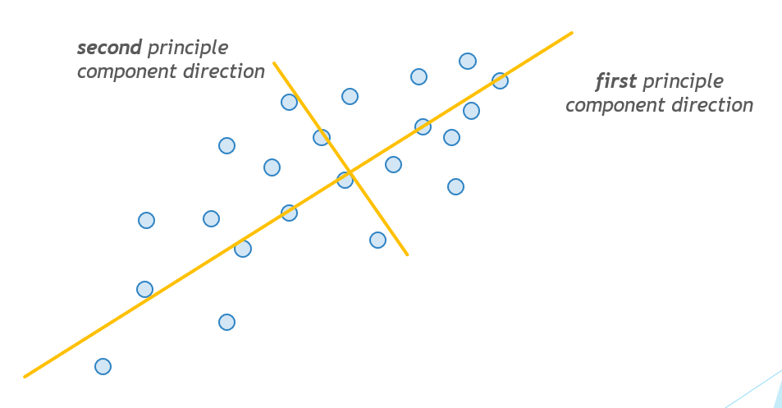
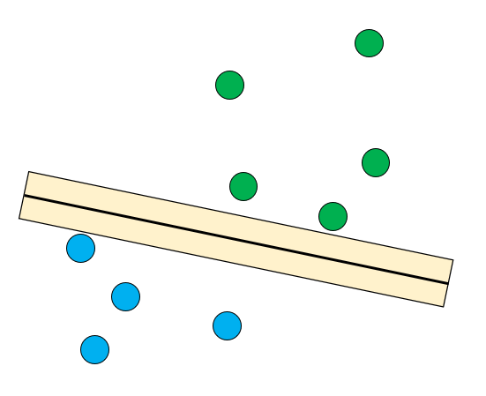
Eigenvectors Applications
64 x 64 pixels
let’s assume that a single image
contains 64x64 pixels
(there are 4096 features to learn)
we have the input images
and we want to use machine learning
algorithms to recignize these faces
support vector classifier
(SVM)
these principle components
(eigenvectors) are the new
input features
we can use PCA that can
find the most relevant features
(set of pixels) that are the eigenvectors

Slide 94
Eigenvectors Applications
64 x 64 pixels
let’s assume that a single image
contains 64x64 pixels
(there are 4096 features to learn)
we have the input images
and we want to use machine learning
algorithms to recignize these faces
„We can transform higher dimensional problems in lower dimensional ones with principle components and eigenvectors”
support vector classifier
(SVM)
these principle components
(eigenvectors) are the new
input features
we can use PCA that can
find the most relevant features
(set of pixels) that are the eigenvectors

Slide 95
PageRank Algorithm (Numerical Methods)

Slide 96

PageRank Algorithm
the oiginal problem is that we want to rank websites
in their search engine search results

Slide 97
PageRank Algorithm
HYPERTEXT INDUCED TOPIC SEARCH (HITS)
it is a link analysis algorithm that rates web pages
developed by Jon Kleinberg

Slide 98
PageRank Algorithm
HYPERTEXT INDUCED TOPIC SEARCH (HITS)
it is a link analysis algorithm that rates web pages
developed by Jon Kleinberg
PAGERANK ALGORITHM
it is a link analysis algorithm and it assigns a numerical weighting to each element of a hyperlinked set of documents

Slide 99
PageRank Algorithm
The world wide web (WWW) hyperlink structure forms a huge directed G(V,E) graph
where the V nodes represent web pages and the E directed edges are the hyperlinks
www.hp.com
www.bbc.com
www.globalsoftware.com
www.cnn.com
www.hp.com
www.youtube.com
www.udemy.com
www.google.com

Slide 100
PageRank Algorithm
The world wide web (WWW) hyperlink structure forms a huge directed G(V,E) graph
where the V nodes represent web pages and the E directed edges are the hyperlinks
BASIC CONCEPT BEHIND PAGERANK ALGORITHM
„PageRank works by counting the number and quality of links to a page to determine a rough estimate of how important the website is. The underlying assumption is that more important websites are likely to receive more links from other websites”
www.hp.com
www.bbc.com
www.globalsoftware.com
www.cnn.com
www.hp.com
www.youtube.com
www.udemy.com
www.google.com

Slide 101
PageRank Algorithm
1.) INBOUND LINKS these are links into the given website from outside
so from other pages and websites
2.) OUTBOUND LINKS these are links from the given website to pages
in the same site or other pages and websites
3.) DANGLING LINKS these are links that are pointing to any page with
no outgoing links

Slide 102
PageRank Algorithm
The first problem is that we have to know the topology of the world wide web (WWW) and
this is exactly the reason why web crawlers came to be
1.) depth-first search is a powerful graph traversal algorithm but in this case
it is not the best approach possible
2.) breadth-first search is a better option because we want to visit the neigbors of
a given node (website) before visiting other nodes of the G(V,E) graph

Slide 103
PageRank Algorithm
The original PageRank formula with summation:
PR(T )
PR(T )
PR(T )
1
2
n
PR(A) = (1-d) + d ( + + ... + )
C(T )
C(T )
C(T )
1
2
n
PR(A) page rank of page A – it is kind of a recursive formula because
it depends on other pages’ page rank
PR(T ) page rank of pages T which link to page A
C(T ) number of outbound links on a given T page
d damping factor in the range [0,1]
i
i
i
i

Slide 104
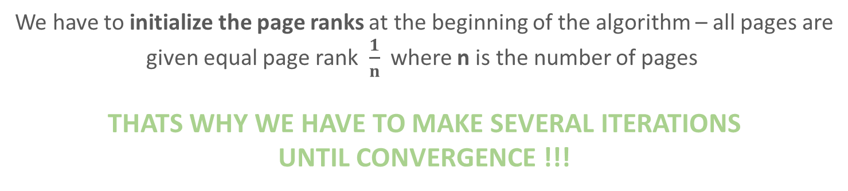
PageRank Algorithm
The original PageRank formula with summation:
PR(T )
PR(T )
PR(T )
1
2
n
PR(A) = (1-d) + d ( + + ... + )
C(T )
C(T )
C(T )
1
2
n
We have to initialize the page ranks at the beginning of the algorithm – all pages are
given equal page rank $\frac{1}{n}$ where n is the number of pages
THATS WHY WE HAVE TO MAKE SEVERAL ITERATIONS
UNTIL CONVERGENCE !!!

Slide 105

PageRank Algorithm
The original PageRank formula with iteration:
PR (P )
t
j
PR (P ) =
t+1
i
C(P )
P
j
j

Slide 106
PageRank Algorithm
PAGE 1
PAGE 2
PAGE 4
PAGE 3

Slide 107
PageRank algorithm
A
B
Iteration 0 Iteration 1 Iteration 2 PageRank
A
B
C
D
C
D

Slide 108
PageRank algorithm
A
B
Iteration 0 Iteration 1 Iteration 2 PageRank
A
B
C
D
1/4
C
1/4
1/4
D
1/4

Slide 109
PageRank algorithm
A
B
Iteration 0 Iteration 1 Iteration 2 PageRank
A
B
C
D
1/4
1/12
C
1/4
1/4
D
1/4
1
4
PR(A) =
3

Slide 110
PageRank algorithm
A
B
Iteration 0 Iteration 1 Iteration 2 PageRank
A
B
C
D
1/4
1/12
C
1/4
2.5/12
1/4
D
1/4
1
1
4
4
PR(B) = +
2
3

Slide 111
PageRank algorithm
A
B
Iteration 0 Iteration 1 Iteration 2 PageRank
A
B
C
D
1/4
1/12
C
1/4
2.5/12
1/4
4.5/12
D
1/4
1
1
4
4
PR(C) = +
2
1

Slide 112
PageRank algorithm
A
B
Iteration 0 Iteration 1 Iteration 2 PageRank
A
B
C
D
1/4
1/12
C
1/4
2.5/12
1/4
4.5/12
D
1/4
4/12
1
1
4
4
PR(D) = +
3
1

Slide 113
PageRank algorithm
A
B
Iteration 0 Iteration 1 Iteration 2 PageRank
A
B
C
D
1/4
1/12
C
1/4
2.5/12
1/4
4.5/12
D
1/4
4/12

Slide 114
PageRank algorithm
A
B
Iteration 0 Iteration 1 Iteration 2 PageRank
A
B
C
D
1/4
1/12
1.5/12
C
1/4
2.5/12
1/4
4.5/12
D
1/4
4/12
4.5
12
PR(A) =
3

Slide 115
PageRank algorithm
A
B
Iteration 0 Iteration 1 Iteration 2 PageRank
A
B
C
D
1/4
1/12
1.5/12
C
1/4
2.5/12
2/12
1/4
4.5/12
D
1/4
4/12
1
4.5
12
12
PR(B) = +
2
3

Slide 116
PageRank algorithm
A
B
Iteration 0 Iteration 1 Iteration 2 PageRank
A
B
C
D
1/4
1/12
1.5/12
C
1/4
2.5/12
2/12
1/4
4.5/12
4.5/12
D
1/4
4/12
1
4
12
12
PR(C) = +
2
1

Slide 117
PageRank algorithm
A
B
Iteration 0 Iteration 1 Iteration 2 PageRank
A
B
C
D
1/4
1/12
1.5/12
C
1/4
2.5/12
2/12
1/4
4.5/12
4.5/12
D
1/4
4/12
4/12
2.5
4.5
12
12
PR(D) = +
1
3

Slide 118
PageRank algorithm
A
B
Iteration 0 Iteration 1 Iteration 2 PageRank
A
B
C
D
1/4
1/12
1.5/12
1
C
1/4
2.5/12
2/12
2
1/4
4.5/12
4.5/12
4
D
1/4
4/12
4/12
3

Slide 119
PageRank - Matrix Representation
We can use matrix operations instead of the iterative approach: we updated
values one by one during the iterative approach but we can use matrix
operations to do multiple calculations at the same time
A
B
C
D

Slide 120





PageRank - Matrix Representation
We can use matrix operations instead of the iterative approach: we updated
values one by one during the iterative approach but we can use matrix
operations to do multiple calculations at the same time
A
B
$$\frac{1}{3}$$
0
0
0
$$\frac{1}{2}$$
$$\frac{1}{3}$$
0
0
C
$$\frac{1}{2}$$
0
0
1
0
1
$$\frac{1}{3}$$
0
D

Slide 121
PageRank - Matrix Representation
We can use matrix operations instead of the iterative approach: we updated
values one by one during the iterative approach but we can use matrix
operations to do multiple calculations at the same time
A
B
$$\frac{1}{3}$$
0
0
0
$$\frac{1}{2}$$
$$\frac{1}{3}$$
PR =
PR
0
0
H
t+1
=
t
C
$$\frac{1}{2}$$
0
0
1
„power method”
0
1
$$\frac{1}{3}$$
0
D

Slide 122


PageRank - Matrix Representation
We can come to the conclusion that we have to multiply the matrix with a
vector in every single iteration
What is the initial vector? It is the initial page rank assigned to every page
A
B
$$\frac{1}{4}$$
$$\frac{1}{4}$$
C
v =
$$\frac{1}{4}$$
$$\frac{1}{4}$$
D

Slide 123
PageRank - Matrix Representation
We can come to the conclusion that we have to multiply the matrix with a
vector in every single iteration
What is the initial vector? It is the initial page rank assigned to every page
A
B
$$\frac{1}{4}$$
v = H v
2
=
$$\frac{1}{4}$$
C
v =
$$\frac{1}{4}$$
$$\frac{1}{4}$$
D

Slide 124
PageRank - Matrix Representation
We can come to the conclusion that we have to multiply the matrix with a
vector in every single iteration
What is the initial vector? It is the initial page rank assigned to every page
A
B
$$\frac{1}{4}$$
v = H v
2
=
$$\frac{1}{4}$$
2
v = H v = H ( H v ) = H v
C
3
=
2
=
=
=
v =
$$\frac{1}{4}$$
$$\frac{1}{4}$$
D

Slide 125
PageRank - Matrix Representation
We can come to the conclusion that we have to multiply the matrix with a
vector in every single iteration
What is the initial vector? It is the initial page rank assigned to every page
A
B
$$\frac{1}{4}$$
v = H v
2
=
$$\frac{1}{4}$$
2
v = H v = H ( H v ) = H v
C
3
=
2
=
=
=
v =
n
$$\frac{1}{4}$$
v = H v
n
$$\frac{1}{4}$$
AFTER SEVERAL ITERATIONS IT CONVERGES TO
THE v EQUILIBRIUM STATE !!!
D

Slide 126
Steady State Approach
We can use matrix operations instead of the iterative approach – we can construct a
transition matrix based on the G(V,E) directed graph
THE STEADY STATE IS WHEN THE EIGNEVALUE IS 1
A
B
$$\frac{1}{3}$$
0
0
0
$$\frac{1}{2}$$
$$\frac{1}{3}$$
0
0
C
$$\frac{1}{2}$$
0
0
1
0
1
$$\frac{1}{3}$$
0
D

Slide 127
Steady State Approach
We can use matrix operations instead of the iterative approach – we can construct a
transition matrix based on the G(V,E) directed graph
THE STEADY STATE IS WHEN THE EIGNEVALUE IS 1
A
B
H x = x
C
esentially we have to solve an eigenvalue-eigenvector
problem where the eigenvalue is 1
H: this is the transition matrix of the hyperlinks
x: this is the final page rank of the given pages
=
D

Slide 128
Steady State Approach
Importance of a given webpage is measured by its popularity – so the number of hyperlinks
pointing to that given page
PageRank can be defined by the probability that a random surfer on the
web starts on a random page and follows
hyperlinks to visit given webpages
A
B
sum of column values equals 1 because of the
probabilities (it is like Markov-chains)
C
D

Slide 129
Steady State Approach
Importance of a given webpage is measured by its popularity – so the number of hyperlinks
pointing to that given page
PageRank can be defined by the probability that a random surfer on the
web starts on a random page and follows
hyperlinks to visit given webpages
A
B
sum of column values equals 1 because of the
probabilities (it is like Markov-chains)
C
the H so-called transition matrix defines the next steps
D

Slide 130
Steady State Approach
Importance of a given webpage is measured by its popularity – so the number of hyperlinks
pointing to that given page
PageRank can be defined by the probability that a random surfer on the
web starts on a random page and follows
hyperlinks to visit given webpages
A
B
sum of column values equals 1 because of the
probabilities (it is like Markov-chains)
C
the H so-called transition matrix defines the next steps
D
the stationary distribution defines the final PageRank vector

Slide 131
PageRank Algorithm
The models discussed so far are working fine usually – but there are some cases when
they fail (dangling nodes and independent clusters)
dangling nodes are the nodes with no outgoing edges (hyperlinks)
the algorithms disucces so far are not going to work
A
C
B

Slide 132


PageRank Algorithm
The models discussed so far are working fine usually – but there are some cases when
they fail (dangling nodes and independent clusters)
dangling nodes are the nodes with no outgoing edges (hyperlinks)
the algorithms disucces so far are not going to work
A
$$\frac{1}{3}$$
0
0
0
C
v =
$$\frac{1}{3}$$
0
0
0
0
1
1
0
$$\frac{1}{3}$$
B
transition matrix
the inital
page ranks

Slide 133


PageRank Algorithm
The models discussed so far are working fine usually – but there are some cases when
they fail (dangling nodes and independent clusters)
dangling nodes are the nodes with no outgoing edges (hyperlinks)
the algorithms disucces so far are not going to work
A
$$\frac{1}{3}$$
0
C
0
0
0
$$\frac{1}{3}$$
v = =
0
0
0
0
1
1
1
0
$$\frac{1}{3}$$
$$\frac{2}{3}$$
B

Slide 134

PageRank Algorithm
The models discussed so far are working fine usually – but there are some cases when
they fail (dangling nodes and independent clusters)
dangling nodes are the nodes with no outgoing edges (hyperlinks)
the algorithms disucces so far are not going to work
A
0
0
C
0
0
0
v = =
0
0
0
0
0
1
1
1
0
$$\frac{2}{3}$$
0
B

Slide 135
PageRank Algorithm
The models discussed so far are working fine usually – but there are some cases when
they fail (dangling nodes and independent clusters)
dangling nodes are the nodes with no outgoing edges (hyperlinks)
the algorithms disucces so far are not going to work
A
0
0
C
0
0
0
PROBLEM
v = =
0
0
0
0
0
1
1
1
0
$$\frac{2}{3}$$
0
B

Slide 136
PageRank Algorithm
The models discussed so far are working fine usually – but there are some cases when
they fail (dangling nodes and independent clusters)
there may be several independent components (clusters)
in the underlying world wide web (WWW) and
THE MODELS DISCUSSED SO FAR CAN
NOT HANDLE THESE SITUATIONS !!!
A
D
C
E
B

Slide 137

PageRank Algorithm
Using the d damping factor in the range [0,1] can solve all the problems we have discussed
in the previous lectures (dangling nodes and independent clusters)
M = (1-d) A + d B
M: this is the PageRank matrix or Google-matrix
d: damping factor usually 0.15
A: transition matrix
B: identity matrix (items are all 1)
1
1
1
$$\frac{1}{n}$$
1
1
1
1
1
1

Slide 138
PageRank Algorithm
Using the d damping factor in the range [0,1] can solve all the problems we have discussed
in the previous lectures (dangling nodes and independent clusters)
sometimes with little probability the surfer
leave the actual page and navigate to another (random) one
„teleportation”
M = (1-d) A + d B
most of the time with (1-d)
probability the surfer will follow links in
the given page – it will visit one of the neighbors of the actual page

Slide 139
PageRank Algorithm
If a given A matrix is positive and column stochastic matrix:
→ 1 is the largest eigenvalue
→ 1 is an eigenvalue with multiplicity one
→ for the eigenvalue 1 there exists a unique eigenvector with the
sum of its entries equal to 1
=
THE SUM OF ALL PAGES’ PAGERANK IS 1 !!!
„Perron-Frobenius theorem”

Slide 140
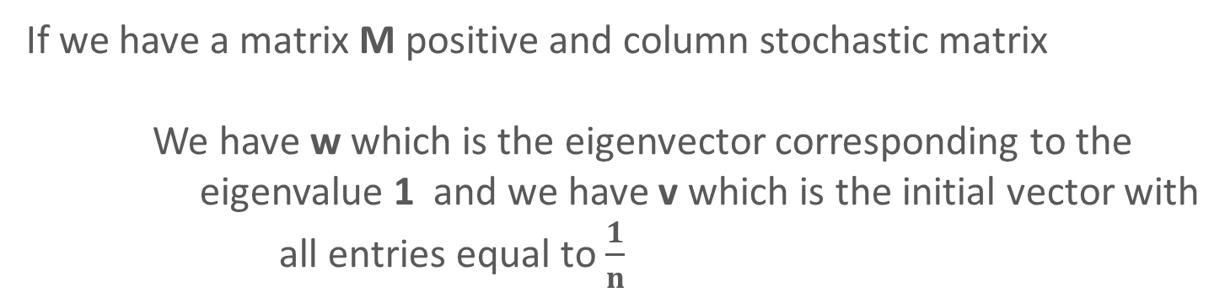
PageRank Algorithm
If we have a matrix M positive and column stochastic matrix
We have w which is the eigenvector corresponding to the
eigenvalue 1 and we have v which is the initial vector with
all entries equal to $\frac{1}{n}$
=
k
→ in this case the sequence v, M v ... M v converges to w
„power method convergence theorem”

Slide 141

PageRank Algorithm
If we have a matrix M positive and column stochastic matrix
We have w which is the eigenvector corresponding to the
eigenvalue 1 and we have v which is the initial vector with
all entries equal to $\frac{1}{n}$
=
THE PROBLEM IS THAT THE M MATRIX IS ENORMOUS !!!
it is quite hard to handle huge matrixes like M so usually we are after some approximation (like with meta-heuristic approaches)
k
→ in this case the sequence v, M v ... M v converges to w
„power method convergence theorem”

Slide 142
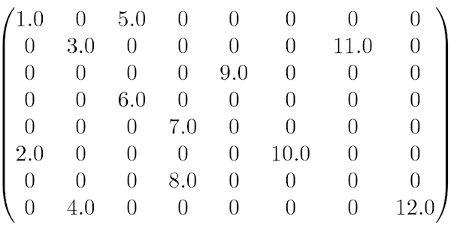
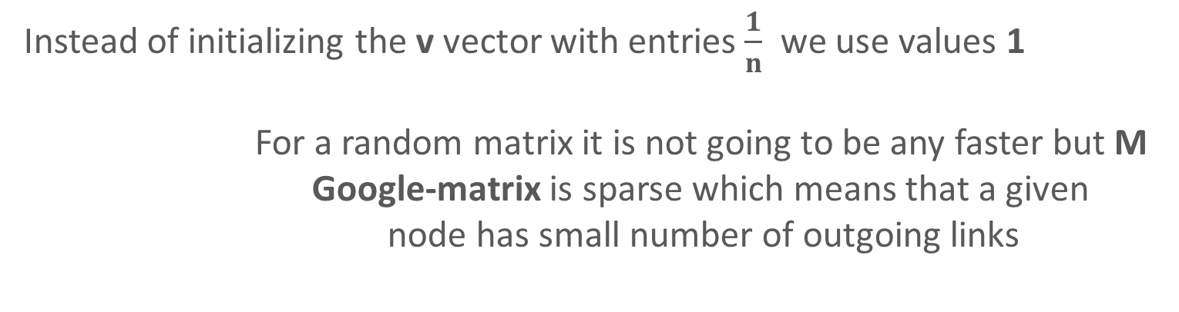
PageRank Algorithm
POWER METHOD APPROXIMATION
Instead of initializing the v vector with entries $\frac{1}{n}$ we use values 1
For a random matrix it is not going to be any faster but M
Google-matrix is sparse which means that a given
node has small number of outgoing links

Slide 143
Interpolation (Numerical Methods)

Slide 144
Interpolation
y
Given N points such as (x , y ) coordinates on a plane
→ there is some predifined f(x) function
such that f(x ) = y
→ when dealing with regression we do not require
the function to have exact values at given points
with interpolation we require this
INTERPOLATION CURVE IS PASSING THROUGH ALL THE N DATA POINTS !!!
i
i
i
i
x

Slide 145
Interpolation
y
Given N points such as (x , y ) coordinates on a plane
→ there is some predifined f(x) function
such that f(x ) = y
→ when dealing with regression we do not require
the function to have exact values at given points
with interpolation we require this
INTERPOLATION CURVE IS PASSING THROUGH ALL THE N DATA POINTS !!!
i
i
i
i
x

Slide 146
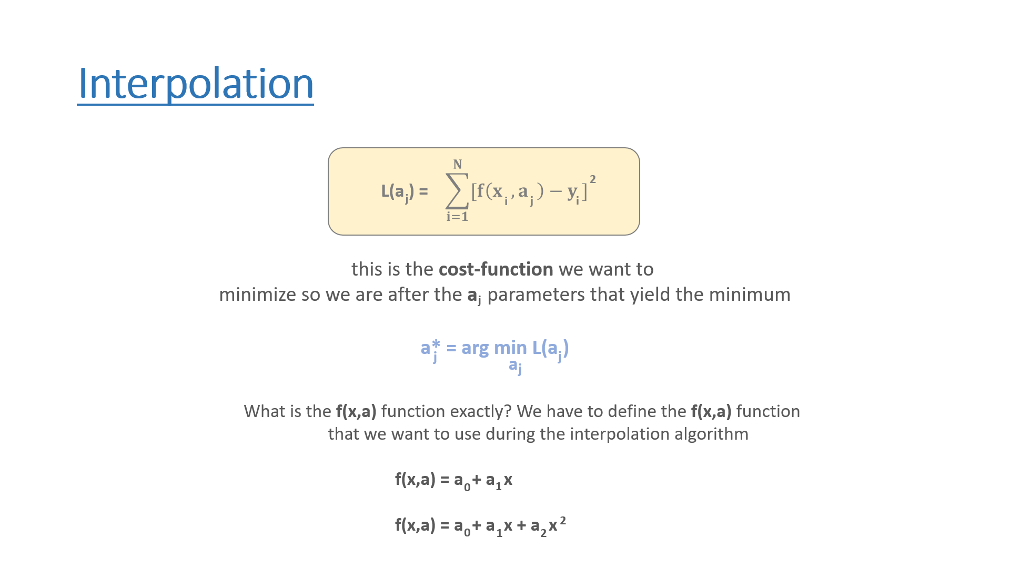

Interpolation
$$\sum_{i=1}^{N}{[f\left(x ,a \right)−y ]}$$
L(a ) =
2
j
i
j
i
this is the cost-function we want to
minimize so we are after the a parameters that yield the minimum
j
a* = arg min L(a )
j
a
j
j
What is the f(x,a) function exactly? We have to define the f(x,a) function
that we want to use during the interpolation algorithm
f(x,a) = a + a x
f(x,a) = a + a x + a x
0
1
2
0
1
2

Slide 147
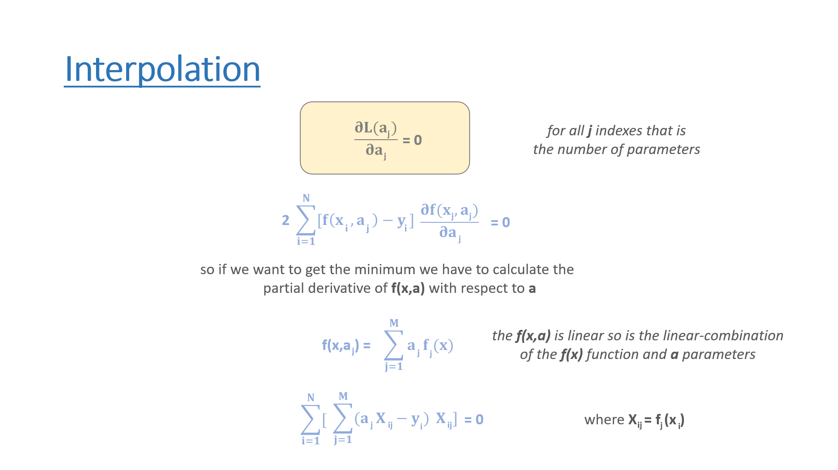






Interpolation
$$\frac{∂L(a )}{∂a }$$
for all j indexes that is
the number of parameters
j
= 0
j
$$\sum_{i=1}^{N}{[f\left(x ,a \right)−y ]}$$
2
$$\frac{∂f(x ,a )}{∂a }$$
j
j
= 0
i
j
i
j
so if we want to get the minimum we have to calculate the
partial derivative of f(x,a) with respect to a
$$\sum_{j=1}^{M}{a f (x)}$$
the f(x,a) is linear so is the linear-combination
of the f(x) function and a parameters
f(x,a ) =
j
j
j
$$\sum_{i=1}^{N}{[}$$
$$\sum_{j=1}^{M}{(a X −y )} X ]$$
j
ij
ij
= 0
where X = f (x )
i
ij
j
i

Slide 148
Interpolation
T
T
X X a = X y
so we can come to the conclusion that we have to solve this
matrix equation (this is an NxM matrix)

Slide 149
Interpolation
y
x = [-2, -1, 0, 1, 2]
y = [5.1, 1.9, 1.1, 2.1, 4.9]
f(x,a) = a + a x + a x
2
0
1
1
2
2
the order of the polinom + 1
x
1
-2
4
1
-1
1
dimension of the input
as many rows as the number of
x values (or y values)
X =
1
0
0
1
1
1
1
2
4

Slide 150
Interpolation
y
x = [-2, -1, 0, 1, 2]
y = [5.1, 1.9, 1.1, 2.1, 4.9]
f(x,a) = a + a x + a x
2
0
1
1
2
2
1
-2
4
x
1
-1
1
5
0
10
15.1
T
T
X =
1
0
0
X X =
0
10
0
X y =
-0.2
1
1
1
10
0
34
44
1
2
4

Slide 151
Interpolation
y
x = [-2, -1, 0, 1, 2]
y = [5.1, 1.9, 1.1, 2.1, 4.9]
f(x,a) = a + a x + a x
2
0
1
1
2
2
5
0
10
a
15.1
x
0
0
10
0
a
=
-0.2
1
10
0
34
a
44
2
it is a system of linear-equations and we are after the a values
we can solve it with Gaussian-elimination
(thats why matrix operations are so important)

Slide 152
Interpolation
y
x = [-2, -1, 0, 1, 2]
y = [5.1, 1.9, 1.1, 2.1, 4.9]
f(x,a) = a + a x + a x
2
0
1
1
2
2
5
0
10
a
15.1
x
0
0
10
0
a
=
-0.2
1
10
0
34
a
44
f(x,a) = 1.049 – 0.02 x + 0.986 x
2
2

Slide 153
Interpolation - Applications
1.) the standard interpolation problem that you have a dataset with N points
and we can approximate the function values (for example: temperature
or stock prices) at points where there data is not available
y
x

Slide 154

Interpolation - Applications
2.) it is quite common in photo editing applications that we change the size of an image
so we stretch the size of the image and generate pixels to fill in the blanks
or a better approach is to use interpolation instead

Slide 155
Root Finding (Numerical Methods)

Slide 156
Roots of Equations
the zeros of a function are the values of the function’s
variable for which the value of the function is zero
f(x) = 0 so x is the root of the function
all root finding algorithms are iterative and needs
an x₀ starting point – an estimate of the root
(a bad starting value may fail to converge)
usually we need to bracket the root so determine its
lower and upper bounds before
applying the algorithms
f(x)
x

Slide 157
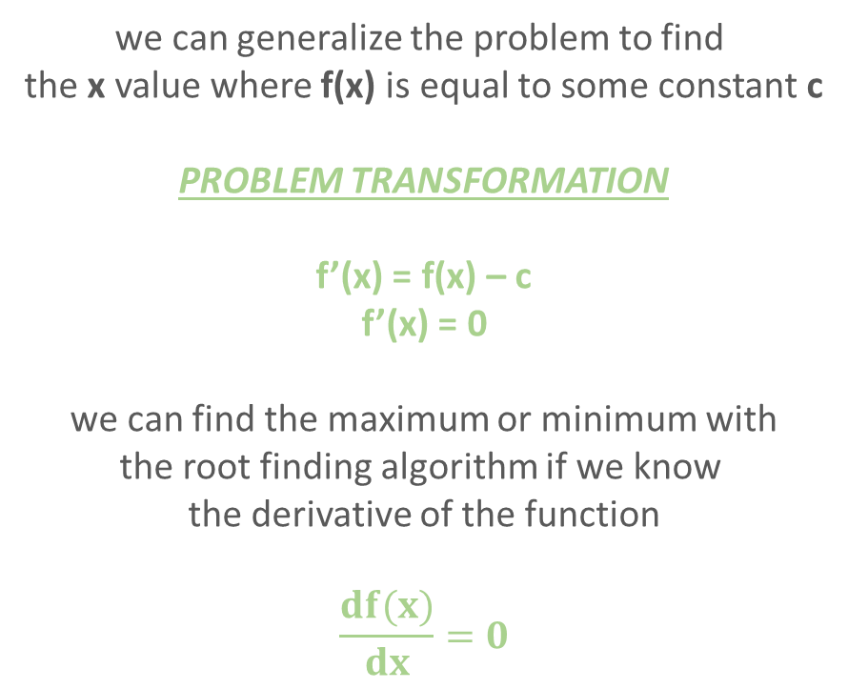
Roots of Equations
we can generalize the problem to find
the x value where f(x) is equal to some constant c
PROBLEM TRANSFORMATION
f’(x) = f(x) – c
f’(x) = 0
we can find the maximum or minimum with
the root finding algorithm if we know
the derivative of the function
$$\frac{df(x)}{dx}=0$$
f(x)
x

Slide 158
Roots of Equations
bisection method that is very similar to the standard binary search algorithm

Slide 159
Roots of Equations
bisection method that is very similar to the standard binary search algorithm
Newton-Raphson method that relies heavily
on the derivative of the f(x) function

Slide 160
Bisection Method (Numerical Methods)

Slide 161
Bisection Method
f(x)
we have two values of x for which the f(x) function
take values of opposite sign
f( ) > 0 f( ) < 0
So we know for sure (if the function is continuous that there
is at least one root of the function in the
x
x
positive
negative
[x , ]
x
positive
negative
x
x
x
positive
negative

Slide 162
Bisection Method
bisection method is very similar to binary search if
we are dealing with discrete data (array of integers)
f(x)
ALGORITHM
1.) calculate x =
2.) if f(x) > 0 then set x = x
otherwise set x = x
3.) repeate the steps until we hit a given precision
abs( x - x ) < ε
x +
x
positive
negative
2
positive
negative
x
x
x
positive
negative
positive
negative

Slide 163
Bisection Method
f(x)
x
x
x
positive
negative

Slide 164
Bisection Method
f(x)
x
x
x
positive
negative

Slide 165
Bisection Method
f(x)
x
x
x
positive
negative

Slide 166
Bisection Method
f(x)
x
x
x
positive
negative

Slide 167
Bisection Method
f(x)
x
x
x
p
negative

Slide 168
Bisection Method
f(x)
x
x
x
p
negative

Slide 169
Bisection Method
f(x)
x
x
x
p
n

Slide 170
Newton-Raphson Method (Numerical Methods)

Slide 171
Newton-Raphson Method
f(x )
X = X -
n
n+1
n
f’(x )
n
we have to use the derivative of the f(x) function and
this is the main disadvantage of this method
this procedure is repeated until the change between the new value
and the preceding one is small enough
the algorithm does not work properly near zero because
the derivative is very small
X - X < ε
n+1
n

Slide 172
Newton-Raphson Method
f(x )
X = X -
n
n+1
n
f’(x )
n
NEWTON’S METHOD IS 5-10 TIMES FASTER
THAN BISECTION METHOD !!!
(bisection method is more robust which means that it always find the root of the f(x) function)
we have to use the derivative of the f(x) function and
this is the main disadvantage of this method
this procedure is repeated until the change between the new value
and the preceding one is small enough
the algorithm does not work properly near zero because
the derivative is very small
X - X < ε
n+1
n

Slide 173
Newton-Raphson Method
f(x)
x

Slide 174
Newton-Raphson Method
f(x)
x
x
1

Slide 175
Newton-Raphson Method
f(x)
x
x
1

Slide 176
Newton-Raphson Method
f(x)
x
x
x
1
2

Slide 177
Newton-Raphson Method
f(x)
x
x
x
1
2

Slide 178
Newton-Raphson Method
f(x)
x
x
x
1
2

Slide 179
Newton-Raphson Method
f(x)
x
x
x
x
1
3
2

Slide 180
Numerical Integral (Numerical Methods)

Slide 181
Numerical Integral
several f(x) function can be integrated easily and of course it has several
applications (in probability theory or calculating surface areas)
several f(x) functions are defined by an integral such as the
gamma function (the generalization of the factorial function)
SOMETIMES WE HAVE TO USE NUMERICAL
METHODS TO GET THE INTEGRAL !!!
because some functions have no closed form integral

Slide 182

Numerical Integral
$$\int_{a}^{b}{f(x) dx}$$
the aim of numerical integration is to find the integral
of the f(x) function within the range [a,b]

Slide 183
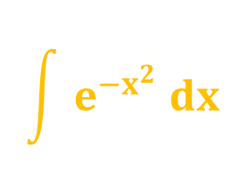
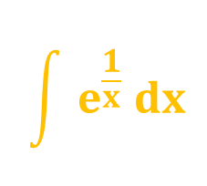
Numerical Integral
$$\int{e^{\frac{1}{x}} dx}$$
$$\int{e^{{−x}^{2}} dx}$$
NO CLOSED FORM !!!
we are not able to calculate the closed-form expressions
because there are no antiderivatives

Slide 184
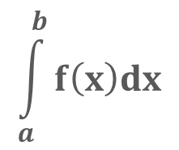
Numerical Integral
numerical integral will approximate the S
value which is the area under the f(x) function
in the range [a,b]
f(x)
$$\int_{a}^{b}{f\left(x\right)dx}$$
S =
S
x
a
b

Slide 185
Numerical Integral
rectangle method approximates the area under the f(x) function with rectangles

Slide 186
Numerical Integral
rectangle method approximates the area under the f(x) function with rectangles
Simpson’s method is way more accurate than the standard rectangle approach

Slide 187
Numerical Integral
rectangle method approximates the area under the f(x) function with rectangles
Simpson’s method is way more accurate than the standard rectangle approach
Monte-Carlo method uses random number and randomization to calculate the integral

Slide 188
Rectangle Method (Numerical Methods)

Slide 189
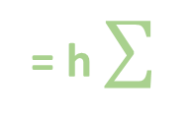
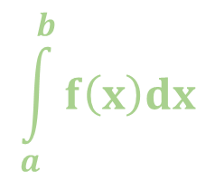
Rectangle Method
Rectangle method approximates the definite integral of a function – so the are
under the curve defined by the f(x) function
→ we can get the area under the f(x) function: we just have to sum up
the area of a collection of rectangles that heights are
determined by the values of the function
f(x)
$$\int_{a}^{b}{f\left(x\right)dx}$$
N-1
= h
f(x )
n
n=0
h = (b-a)/N and x = a + n * h
n
x
a
b

Slide 190
Rectangle Method
f(x)
x
a
b

Slide 191
Rectangle Method
f(x)
x
a
b

Slide 192
Rectangle Method
f(x)
x
a
b

Slide 193
Rectangle Method
f(x)
x
a
b

Slide 194
Rectangle Method
f(x)
x
a
b

Slide 195
Rectangle Method
f(x)
x
a
b

Slide 196
Trapezoidal Method (Numerical Methods)

Slide 197
Trapezoidal Method
rectangle method approximates the definite integral of a function with rectangles but this approach is not that efficient
THE AREA UNDER THE CURVE IS APPROXIMATED
BY THE SUM OF N TRAPEZOID INSTEAD OF RECTANGLES !!!
calculating the area of a trapezoid is
quite easy and fast
f(x)
x
a
b

Slide 198
Trapezoidal Method
rectangle method approximates the definite integral of a function with rectangles but this approach is not that efficient
THE AREA UNDER THE CURVE IS APPROXIMATED
BY THE SUM OF N TRAPEZIA INSTEAD OF RECTANGLES !!!
calculating the area of a trapezium is
quite easy and fast
f(x)
the trapezoidal rule tends to become extremely accurate when periodic functions are integrated over their periods
x
a
b

Slide 199
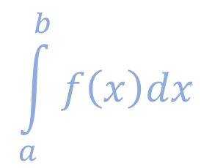
Trapezoidal Method
instead of using rectangles to approximates the definite integral of the f(x) function we use trapezoids instead
calculating the area of a trapezoid is
quite easy and fast
f(x)
$$\int_{a}^{b}{f\left(x\right)dx}$$
x
a
b

Slide 200
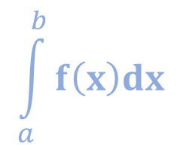
Trapezoidal Method
instead of using rectangles to approximates the definite integral of the f(x) function we use trapezoids instead
calculating the area of a trapezoid is
quite easy and fast
f(x)
$$\int_{a}^{b}{f\left(x\right)dx}$$
f(a) + f(b)
= (b-a)
2
x
a
b

Slide 201
Trapezoidal Method
we create N equal subintervals or N+1
points where we evaluate the function f(x)
f(x)
a = x < x < ... < x = b
1
2
N+1
Where the grid spacing is h = (b-a)/N
$$\int_{a}^{b}{f\left(x\right)dx}$$
f(a) + f(b)
= (b-a)
2
x
a
b

Slide 202

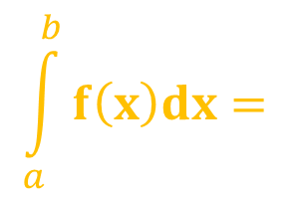
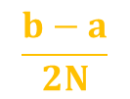
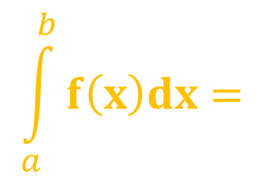
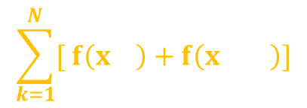
Trapezoidal Method
$$\int_{a}^{b}{f\left(x\right)dx= }$$
$$\frac{h}{2}$$
$$\sum_{k=1}^{N}{[ f\left(x \right)+f\left(x \right)]}$$
~
k
k+1
$$\int_{a}^{b}{f\left(x\right)dx= }$$
~
$$\frac{b−a}{2N}$$
[ f(x ) + 2 f(x ) + ... + 2 f(x ) + f(x ) ]
1
2
N
N+1

Slide 203
Trapezoidal Method
f(x)
x
a
b

Slide 204
Trapezoidal Method
f(x)
x
a
b

Slide 205
Trapezoidal Method
f(x)
x
a
b

Slide 206
Trapezoidal Method
f(x)
x
a
b

Slide 207
Trapezoidal Method
f(x)
x
a
b

Slide 208
Simpson’s Method (Numerical Methods)

Slide 209
Simpson’s Method
this is a method for numerical integration – the numerical approximation of definite integrals
essentially it is a quadratic interpolation
the error of the algorithm is proportional to the 4th derivative
it yields better results than trapezoidal rule
here we have a start point a and end point b and an additional middle point at (a+b)/2

Slide 210
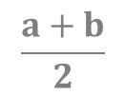
Simpson’s Method
$\int_{a}^{b}{f\left(x\right)dx=}$ $\frac{b−a}{6}[ f\left(a\right)+4f\left(\frac{a+b}{2}\right)+f\left(b\right) ]$
f(x)
f(x): the function itself
P(x): the quadratic interpolation
m: the middle point (a+b)/2
f(x)
P(x)
x
a
$$\frac{a+b}{2}$$
b

Slide 211
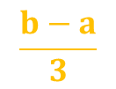

Simpson’s Method
$$\int_{a}^{b}{f\left(x\right)dx= }$$
~
$$\frac{b−a}{3}$$
[ f(x ) + 4 f(x ) + 2 f(x ) + ... + 2 f(x ) + 4 f(x ) + f(x ) ]
0
1
2
N-2
N-1
N

Slide 212
Trapezoidal Method
f(x)
x
a
x₁
x₂
x₃
b

Slide 213
Trapezoidal Method
f(x)
x
a
x₁
x₂
x₃
b

Slide 214
Trapezoidal Method
f(x)
x
a
x₁
x₂
x₃
b

Slide 215
Monte-Carlo Method (Numerical Methods)

Slide 216
Monte-Carlo Method
this method was first used back in the 1940s during the Manhattan Project at Los Alamos
John von Neumann, Stanislaw Ulam and Nicholas Metropolis applied this method to nuclear physics related problems
Monte-Carlo method solves a deterministic
problem using probabilistic methods

Slide 217
Monte-Carlo Method
numerically computes a definite integral on a given interval
Monte-Carlo approach randomly choose points at which the integrand is evaluated (non-deterministic approach)
because of the non-deterministic feature it may yield different results
relies on the law of large numbers so uniformly distributed random numbers are needed
this method is particularly useful for higher-dimensional integrals this is why it is popular in finance and physics

Slide 218
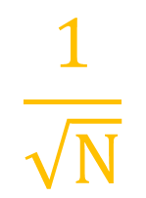
Monte-Carlo Method
$$\frac{1}{\sqrt{N}}$$
we have to quadruple the number of simulations
to double the accuracy of your approximation
but there is no dependence on dimensions
in low dimensions for example integrating one-dimensional
functions other methods are better (Simpson’s method)
→ in high dimensions Monte-Carlo algorithm outperforms other methods

Slide 219
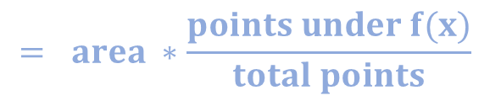
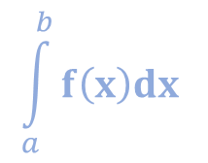
Monte-Carlo Method
we keep generating point in a 2 dimensional
plane and the integral of f(x) function is approximately
given by the total area times the fraction of
points that fall under the f(x) function
f(x)
$$\int_{a}^{b}{f\left(x\right)dx }$$
$$= area ∗\frac{points under f(x)}{total points}$$
x
a
b

Slide 220
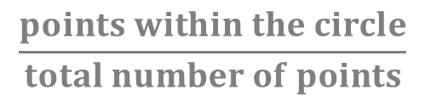
Monte-Carlo Method
for example we have to calculate the
area of the circle within a square
WE CAN GENERATE RANDOM POINTS
ON THE TWO-DIMENSIONAL PLANE
we just have to count the relative frequency
of points inside the circle
a
a
A_{circle} = a²
$$\frac{points within the circle}{total number of points}$$

Slide 221
Monte-Carlo Method
we keep generating point in a 2 dimensional
plane and the integral of f(x) function is approximately
given by the total area times the fraction of
points that fall under the f(x) function
f(x)
$$\int_{a}^{b}{f\left(x\right)dx }$$
$$= area ∗\frac{points under f(x)}{total points}$$
x
a
b

Slide 222
Monte-Carlo Method
we keep generating point in a 2 dimensional
plane and the integral of f(x) function is approximately
given by the total area times the fraction of
points that fall under the f(x) function
f(x)
$$\int_{a}^{b}{f\left(x\right)dx }$$
$$= area ∗\frac{points under f(x)}{total points}$$
x
a
b

Slide 223
Monte-Carlo Method
we keep generating point in a 2 dimensional
plane and the integral of f(x) function is approximately
given by the total area times the fraction of
points that fall under the f(x) function
f(x)
$$\int_{a}^{b}{f\left(x\right)dx }$$
$$= area ∗\frac{points under f(x)}{total points}$$
x
a
b

Slide 224
Monte-Carlo Method
we keep generating point in a 2 dimensional
plane and the integral of f(x) function is approximately
given by the total area times the fraction of
points that fall under the f(x) function
f(x)
$$\int_{a}^{b}{f\left(x\right)dx }$$
$$= area ∗\frac{points under f(x)}{total points}$$
x
a
b

Slide 225
Monte-Carlo Method
we keep generating point in a 2 dimensional
plane and the integral of f(x) function is approximately
given by the total area times the fraction of
points that fall under the f(x) function
f(x)
$$\int_{a}^{b}{f\left(x\right)dx }$$
$$= area ∗\frac{points under f(x)}{total points}$$
x
a
b

Slide 226
Monte-Carlo Method
we keep generating point in a 2 dimensional
plane and the integral of f(x) function is approximately
given by the total area times the fraction of
points that fall under the f(x) function
f(x)
$$\int_{a}^{b}{f\left(x\right)dx }$$
$$= area ∗\frac{points under f(x)}{total points}$$
x
a
b

Slide 227
Monte-Carlo Method
we keep generating point in a 2 dimensional
plane and the integral of f(x) function is approximately
given by the total area times the fraction of
points that fall under the f(x) function
f(x)
$$\int_{a}^{b}{f\left(x\right)dx }$$
$$= area ∗\frac{points under f(x)}{total points}$$
x
a
b

Slide 228
Monte-Carlo Method
we keep generating point in a 2 dimensional
plane and the integral of f(x) function is approximately
given by the total area times the fraction of
points that fall under the f(x) function
f(x)
$$\int_{a}^{b}{f\left(x\right)dx }$$
$$= area ∗\frac{points under f(x)}{total points}$$
x
a
b

Slide 229
Monte-Carlo Method
we keep generating point in a 2 dimensional
plane and the integral of f(x) function is approximately
given by the total area times the fraction of
points that fall under the f(x) function
f(x)
$$\int_{a}^{b}{f\left(x\right)dx }$$
$$= area ∗\frac{points under f(x)}{total points}$$
x
a
b

Slide 230
Applications of the Monte-Carlo Method (Numerical Methods)

Slide 231
Monte-Carlo Simulations
WHAT IS THE BASIC PRINCIPLE?
we can estimate the possible outcomes of an uncertain events
have to generate several possible outcomes and then we have to calculate the average of these outcomes
the more iterations we make the better will be the prediction

Slide 232
Monte-Carlo Simulations
dS = 𝝻 S dt + 𝞂 S dX
we know that S(t) assets (such as stocks)
follow lognormal random work
IF WE KNOW THE S(0) STARTING POINT OF THE STOCK PRICE AND WE KNOW THE 𝝻 and 𝞂 PARAMETERS
THEN WE CAN MAKE MULTIPLE SIMULATIONS
it is quite cheap to create simulations like these we know
how to simulate lognormal random walks
THE AVERAGE OF THESE SIMULATIONS YIELDS THE FUTURE S(t) PRICE OF THE STOCK !!!

Slide 233
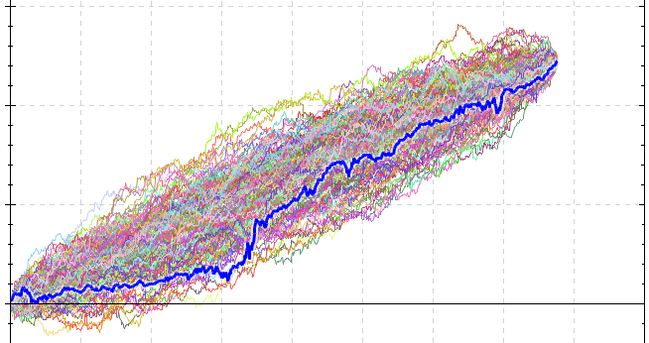
Monte-Carlo Simulations

Slide 234
Differential Equations (Numerical Methods)

Slide 235
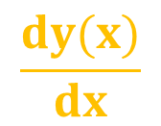
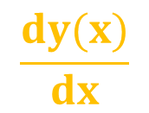
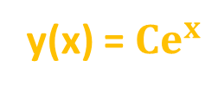
Differential Equations
$$\frac{dy(x)}{dx}$$
= f(x,y)
this is the form of a first order differential equation
for standard equations the solution is a scalar value
3x = 12
x = 4
for differential equations: the solution is a function
$$\frac{dy(x)}{dx}$$
= y
y(x) = ${Ce}^{x}$

Slide 236
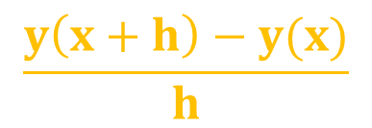





Differential Equations
$$\frac{dy(x)}{dx}$$
= f(x,y)
$$\frac{dy(x)}{dx}$$
$$\frac{y\left(x+h\right)−y(x)}{h}$$
~
$$\frac{dy(x)}{dx}$$
$$\frac{y\left(x+h\right)−y(x)}{h}$$
~
= f(x,y)
$y\left(x+h\right)=y\left(x\right)+h f(x,y)$

Slide 237


Differential Equations
$y\left(x+h\right)=y\left(x\right)+h f(x,y)$
$$y = y +h f(x ,y )$$
n+1
n
n
n
the h parameter is the so-called step size
(the smaller the value the better the algorithm)
f(x,y) is right side of the differential equation
WE NEED AN INITIAL CONDITION
y(0) = 1

Slide 238




Differential Equations
$$\frac{dy}{dx}$$
= y y(0) = 1
1.) analytical solution: this is the exact solution of an
ordinary differential equation
$$\int{\frac{dy}{y}}$$
$$\int{ dx}$$
=
ln y = x + ln C
y(x) = $e^{x}$

Slide 239

Differential Equations
$$\frac{dy}{dx}$$
= y y(0) = 1
2.) numerical solution: this is just an approximation of the solution
$y\left(x+h\right)=y\left(x\right)+h f(x,y)$
we need this formula with the initial condition
to solve the problem numerically
x = 0 y = 1
0
0

Slide 240
Euler’s Method (Numerical Methods)

Slide 241



Differential Equations
$$\frac{dy}{dx}$$
$$\frac{dy}{dx}$$
x
y
= y y(0) = 1
h = 2
$$y = y +h f(x ,y )$$
n+1
n
n
n

Slide 242
Differential Equations
$$\frac{dy}{dx}$$
$$\frac{dy}{dx}$$
x
y
= y y(0) = 1
h = 2
0 1 1
$$y = y +h f(x ,y )$$
n+1
n
n
n

Slide 243

Differential Equations
$$\frac{dy}{dx}$$
$$\frac{dy}{dx}$$
x
y
= y y(0) = 1
h = 2
0 1 1
2 3 3
$$y = y +h f(x ,y )$$
n+1
n
n
n
$$y = y +2 ∗1=1+2=3$$
2
1

Slide 244

Differential Equations
$$\frac{dy}{dx}$$
$$\frac{dy}{dx}$$
x
y
= y y(0) = 1
h = 2
0 1 1
2 3 3
4 9 9
$$y = y +h f(x ,y )$$
n+1
n
n
n
$$y = y +2 ∗3=3+6=9$$
3
2

Slide 245

Differential Equations
$$\frac{dy}{dx}$$
$$\frac{dy}{dx}$$
x
y
= y y(0) = 1
h = 2
0 1 1
2 3 3
4 9 9
6 27 27
$$y = y +h f(x ,y )$$
n+1
n
n
n
$$y = y +2 ∗9=9+18=27$$
4
3

Slide 246
Differential Equations
x
y
$$\frac{dy}{dx}$$
y
0 1 1
2 3 3
4 9 9
6 27 27
x

Slide 247
Differential Equations
x
y
$$\frac{dy}{dx}$$
y
0 1 1
2 3 3
4 9 9
6 27 27
in the exact case the slope is
changing but we assume the
slope is fixed until the next x point
x

Slide 248
Euler’s Method - Pendulum (Numerical Methods)

Slide 249
Pendulum

Slide 250


Pendulum
we assume that the angle is very small
which means that we can approximate the
sin(x) function with x
l
Φ
sin(Φ) = $\frac{x}{l}$
x = l sin(Φ) ~ l Φ
mg sin(Φ)
mg cos(Φ)
mg
2
F = m a = m l $\frac{d Φ}{dt}$
2

Slide 251
Pendulum
we assume that the angle is very small
which means that we can approximate the
sin(Φ) function with Φ
l
Φ
sin(Φ) = $\frac{x}{l}$
x = l sin(Φ) ~ l Φ
x
2
F = m a = m l $\frac{d Φ}{dt}$
2

Slide 252
Pendulum
we assume that the angle is very small
which means that we can approximate the
sin(Φ) function with Φ
l
Φ
sin(Φ) = $\frac{x}{l}$
x = l sin(Φ) ~ l Φ
-mg sin(Φ)
x
2
F = m a = m l $\frac{d Φ}{dt}$
2

Slide 253


Pendulum
we assume that the angle is very small
which means that we can approximate the
sin(Φ) function with Φ
l
Φ
sin(Φ) = $\frac{x}{l}$
x = l sin(Φ) ~ l Φ
-mg sin(Φ)
x
2
F = m a = m l $\frac{d Φ}{dt}$
2
2
$\frac{d Φ}{dt}$
= - $\frac{g}{l}$ Φ
2

Slide 254


Pendulum with Drag
we assume that the angle is very small
which means that we can approximate the
sin(Φ) function with Φ
l
Φ
sin(Φ) = $\frac{x}{l}$
x = l sin(Φ) ~ l Φ
-mg sin(Φ)
x
2
F = m a = m l $\frac{d Φ}{dt}$
2
2
$\frac{d Φ}{dt}$
= - $\frac{g}{l}$ Φ – b v
2

Slide 255
Runge-Kutta Method (Numerical Methods)

Slide 256
Runge-Kutta Method
Euler’s method does not take the curvature of the
solution into account (linear interpolation)
it estimates the next point based on the rate
of change at the current x point
Euler’s method is unstable – it yields different results
with different h step sizes
RUNGE-KUTTA METHOD TAKES THE CURVATURE
INTO CONSIDERATION !!!!
y
x

Slide 257







Runge-Kutta Method
$$\frac{dy}{dx}$$
= f(x,y)
$$y(x ) = y$$
0
0
k = h f(x , y )
1
n
n
k = h f(x + $\frac{h}{2}$ , y + $\frac{h}{2}$ k )
2
n
n
1
k = h f(x + $\frac{h}{2}$ , y + $\frac{h}{2}$ k )
3
n
n
2
k = h f(x + h , y + h k )
4
n
n
3
$$y = y +$$
$$\frac{1}{6}$$
(k + 2 k + 2 k + k )
n+1
n
1
2
3
4

Slide 258
Runge-Kutta Method
k the increment based on the slope at the beginning of the
interval (basically it is the Euler’s method)
1
k the increment based on the slope at the midpoint of the interval
2
k the increment based on the slope at the midpoint of the interval
3
k the increment based on the slope at the end of the interval
4

Slide 259
Runge-Kutta Method
k the increment based on the slope at the beginning of the
interval (basically it is the Euler’s method)
1
So Euler’s method is a first order Runge-Kutta approach and of course Runge-Kutta approach yields better results
(the error term is smaller usually)
k the increment based on the slope at the midpoint of the interval
2
k the increment based on the slope at the midpoint of the interval
3
k the increment based on the slope at the end of the interval
4

Slide 260
Gradient Descent (Numerical Methods)

Slide 261
Gradient Descent
gradient descent is a first-order iterative optimization algorithm for finding a local minimum of a differentiable function
it was first proposed by Cauchy back in 1847

Slide 262

Gradient Descent
gradient descent is a first-order iterative optimization algorithm for finding a local minimum of a differentiable function
it was first proposed by Cauchy back in 1847
f(x)
the derivative of the f(x) cost-function
is pointing in the direction of the maximum
$$\frac{df(x)}{dx}$$
x

Slide 263
Gradient Descent
gradient descent is a first-order iterative optimization algorithm for finding a local minimum of a differentiable function
it was first proposed by Cauchy back in 1847
f(x)
the negative derivative of the f(x) cost-function
is pointing in the direction of the minimum
$$\frac{df(x)}{dx}$$
-
x

Slide 264





Gradient Descent
We have to know the partial derivative of the C(b) cost function
and go to the direction of the gradient (partial derivative)
C(b)
$$\frac{∂C(b)}{∂b}$$
$$\frac{∂C(b)}{∂b}$$
0
1
the f(x) gradient of a given f(x) function
is pointing in the direction of maximum
Δ
we are after the minimum so we have to use
- f(x) instead (negative gradient)
b
Δ
1
b
make iterations {
}
0
$$\frac{∂C(b)}{∂b}$$
$$\frac{∂C(b)}{∂b}$$
b ← b – α
b ← b – α
0
0
1
1
0
1

Slide 265
Gradient Descent
α: learning-rate
→ small learning-rate: the algorithm takes small
steps towards the minimum and it takes
more time to converge
→ large learning-rate: the algorithm takes big
steps towards the minimum so the algorithm
is faster but not as accurate
C(b)
b
1
b
0

Slide 266
Stochastic Gradient Descent (Numerical Methods)

Slide 267
Linear Regression
Salary
Age

Slide 268

Linear Regression
Mean Squared Error (MSE)
it is the difference between the y labels present in the
dataset (supervised learning) and the H(x) values
predicted by the model
ε₇
ε₉
ε₄
ε₆
ε₈
ε₁
ε₃
ε₅
[ H(x) – y ]²
„cost-function”
ε₂
if this term is small (small error): it means the model
predictions are very close to the actual values
$$\sum_{i}{ε}$$
MSE =
2
i
if this term is large (large error): it means the model
predictions differ from the actual values

Slide 269

Linear Regression
OPTIMIZATION PROBLEM
this is why optimization algorithms are so important
no matter what problems we are dealing with finally we have to use
some optimization methods to solve it
H(x) is the prediction from
our linear model (linear regression)
min ${[H\left(x\right)−y]}^{2}$
OPTIMIZATION !!!
b
we want to find the minimum
by tuning these parameters
y is the value we know from
the training data

Slide 270
Gradient Descent
Salary
Age

Slide 271
Gradient Descent
Salary
we have to consider all the features (age and salary) and calculate the partial derivatives + we have to plug all the data points into the equations to make a single update for the model
Age

Slide 272
Gradient Descent
Salary
Age

Slide 273
Gradient Descent
Salary
Age

Slide 274
Gradient Descent
Salary
Age

Slide 275
Gradient Descent
Salary
Age

Slide 276
Gradient Descent
Salary
Age

Slide 277
Gradient Descent
Salary
Age

Slide 278
Gradient Descent
Salary
Age

Slide 279
Gradient Descent
Salary
Age

Slide 280
Gradient Descent
Salary
Age

Slide 281
Gradient Descent
Salary
Age

Slide 282
Gradient Descent
Salary
Age

Slide 283
Gradient Descent
Salary
Age

Slide 284
Gradient Descent
Salary
Age

Slide 285
Gradient Descent
Salary
Age

Slide 286
Gradient Descent
Salary
Age

Slide 287
Gradient Descent
Salary
if there are 1.000 features in the model and there are 1.000.000 samples in the dataset then we have to make 1.000.000.000 calculations in a single iteration
GRADIENT DESCENT DOES NOT SCALE
WELL WITH BIG DATA !!!
Age

Slide 288
Stochastic Gradient Descent (SGD)
gradient descent considers all the data samples (in the training dataset) to make an update on the model
the problem is that it is too slow (does not scale well)
SOLUTION: LET’S USE UST ONE (OR A FEW) SAMPLES TO MAKE A SINGLE UPDATE !!!
this is exactly what stochastic gradient descent does
it selects a random sample to make the next update on the model
usually a better approach is to select a subset of the samples at random (minibatches) to make an update
an epoch is when all the minibatches have been considered once

Slide 289
Gradient Descent
Salary
Age

Slide 290
Gradient Descent
Salary
Age

Slide 291
Gradient Descent
Salary
Age

Slide 292
Gradient Descent
Salary
Age

Slide 293
Gradient Descent
Salary
Age

Slide 294
Gradient Descent
Salary
Age

Slide 295
Gradient Descent
Salary
Age

Slide 296
Linear Regression
loss (error)
GRADIENT DESCENT
STOCHASTIC GRADIENT DESCENT (SGD)
# iterations (time)

Slide 297


Linear Regression
$$\sum_{i=1}^{N}{}$$
$$\frac{1}{N}$$
C(b,m) =
[(b+m x_{i}) – y_{i}]²
we can express the C(b,m) cost-function
because this is the formula we need fr gradient descent

Slide 298




Linear Regression
$$\sum_{i=1}^{N}{}$$
$$\frac{2}{N}$$
$\frac{∂C}{∂b}$ = = 2 mean([(b+m x_{i}) – y_{i}])
[(b+m x_{i}) – y_{i}]

Slide 299



Linear Regression
$$\sum_{i=1}^{N}{}$$
$$\frac{2}{N}$$
$\frac{∂C}{∂m}$ = = 2 mean([(b+m x_{i}) – y_{i}] x_{i})
[(b+m x_{i}) – y_{i}] x_{i}

Slide 300
Gradient Descent with Momentum (Numerical Methods)

Slide 301
Gradient Descent with Momentum
gradient descent relies extremely heavily on the curve (the C cost-function itself)
if the curve is larger then the gradient (derivative) is larger as well – so we make larger steps (larger updates)
GRADIENT DESCENT HAS THE TENDENCY TO OSCIALLATE
which means that the large steps are not taken in the exact direction of the minimum
with momentum we can calculate the average of the gradient – so we take the previous values into consideration

Slide 302
Gradient Descent with Momentum

Slide 303
Gradient Descent with Momentum

Slide 304
Gradient Descent with Momentum

Slide 305
Gradient Descent with Momentum

Slide 306
Gradient Descent with Momentum

Slide 307
Gradient Descent with Momentum

Slide 308
Gradient Descent with Momentum

Slide 309
Gradient Descent with Momentum

Slide 310
Gradient Descent with Momentum

Slide 311
Gradient Descent with Momentum

Slide 312
Gradient Descent with Momentum

Slide 313
Gradient Descent with Momentum

Slide 314
Gradient Descent with Momentum

Slide 315
Gradient Descent with Momentum

Slide 316
Gradient Descent with Momentum

Slide 317
Gradient Descent with Momentum

Slide 318
Gradient Descent with Momentum

Slide 319
Adaptive Gradient (AdaGrad) (Numerical Methods)

Slide 320
Adaptive Gradient (AdaGrad)
f(x)
f(x)
x
x
small α learning rate means smaller
steps in every iteration
(slow algorithm)
large α learning rate means larger
steps in every iteration
(fast but inaccurate algorithm)

Slide 321
Adaptive Gradient (AdaGrad)
f(x)
f(x)
the problem with the standard gradient descent algorithm is that we make larger updates when the gradient is larger (and smaller updates when the gradient is smaller)
WE SHOULD CHANGE THE LERNING RATE INDEPENDENTLY
FOR EVERY FEATURE (GRADIENT)
x
x
small α learning rate means smaller
steps in every iteration
(slow algorithm)
large α learning rate means larger
steps in every iteration
(fast but inaccurate algorithm)

Slide 322
Adaptive Gradient (AdaGrad)
AdaGrad was first constructed back in 2011 by John Duchi
the problem with gradient descent is that the α learning rate is the same for every feature (parameter)
every feature (parameter) has an independent learning rate
parameters with large gradients have a correspondigly rapid decrease in their learning rate and vica-versa
it is not sensitive to the initial learning rate values – as we have seen with standard gradient descent

Slide 323
Adaptive Gradient (AdaGrad)
AdaGrad was first constructed back in 2011 by John Duchi
the problem with gradient descent is that the α learning rate is the same for every feature (parameter)
every feature (parameter) has an independent learning rate
parameters with large gradients have a correspondigly rapid decrease in their learning rate and vica-versa
it is not sensitive to the initial learning rate values – as we have seen with standard gradient descent
„ADAGRAD IS WORKING EXTREMELY FINE WITH COST FUNCTIONS WHERE THE CURVATURE OF THE SEARCH SPACE IS DIFFERENT IN DIFFERENT DIMENSIONS”

Slide 324

Adaptive Gradient (AdaGrad)
$$\sum_{i=1}^{N}{}$$
G =
gradient²
i
we track the gradients of the cost-function
for a given feature in the past

Slide 325

Adaptive Gradient (AdaGrad)
$$\frac{αi}{\sqrt{Gi}+ε}$$
learning_rate_{i} =
we tune the customized learning rate associated with
every single parameter (feature)

Slide 326
RMSProp Algorithm (Numerical Methods)

Slide 327
RMSProp Algorithm
Root Mean Squared Propagation (RMSProp) is a modified version of the AdaGrad algorithm
it was first proposed by Geoffrey Hinton in 2012
the problem with AdaGrad is that it considers all the past gradients
it can result in a very small learning rates – which means of course that the algorithm will be extremely slow
RMSProp uses a decaying average of squared gradients – it is essentially a moving average of past gradients
THE ALGORITHM CAN FOCUS ON RECENT GRADIENTS THAT ARE MORE IMPORTANT

Slide 328
RMSProp Algorithm
s(t) = s(t-1) + g²
the AdaGrad algorithm accumulates the
squared gradients – which means it keeps growing without
bound (due to the lack of normalization)

Slide 329
RMSProp Algorithm
s(t) = β s(t-1) + (1- β) g²
with RMSProp we can use a β decay parameter to
prefer recent gradients (similar to momentum)

Slide 330
ADAM Optimizer (Numerical Methods)

Slide 331
ADAM
Adaptive Movement Estimation (ADAM) is the state-of-the-art optimization algorithm in machine learning
it was first proposed by Diederik P. Kingma and Jimmy Ba in 2014
THE ALGORITHM EFFECTIVELY COMBINES MOMENTUM AND THE RMSPROP APPROACHES
it computes the first moment (mean) and second moment (uncentered variance) of the gradient

Slide 332


ADAM
$$\frac{∂C(b)}{∂b}$$
0
$$\frac{∂C(b)}{∂b}$$
1
ADAM is a gradient based optimization algorithm as well
so we need the g(t) gradients (partial derivatives)

Slide 333
ADAM
m(t) = β₁ m(t-1) + (1- β₁) g(t)
v(t) = β₂ v(t-1) + (1- β₂) g²(t)
we define m, v variables (arrays containing as many items as
the number of features) – this is the first and second moment

Slide 334
ADAM
m’(t) = m(t) / (1-β₁²)
v’(t) = v(t) / (1-β₂²)
these are the corrected m and v variables

Slide 335

ADAM
$$\frac{m′(t) }{\sqrt{v′(t) }+ε}$$
x(t) = x(t-1) -
this is the final formula for updating the variables
and of course v(0)=0 and m(0)=0

